Slide 1
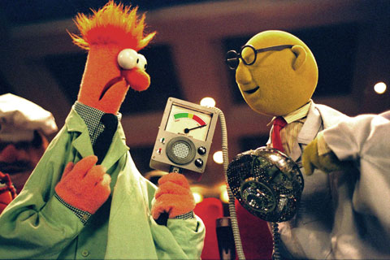


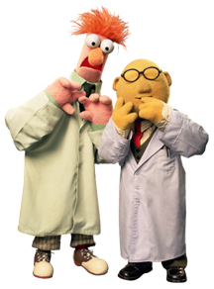
Lab Safety
Lab Safety with
Beaker and Dr.Hunnydu!
Melanie Cossin p.4

Slide 2
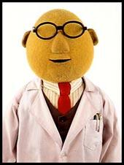
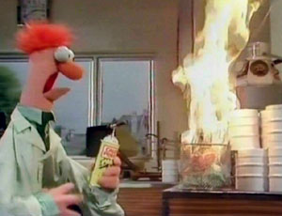
Objective # 1
How do you take responsibility for your safety in a lab? You must pay attention, follow directions and avoid accidents. Take every precaution to prevent accidents. Beaker forgot to read his directions for lighting the candle and… lets just say it didn’t go as planned…

Slide 3
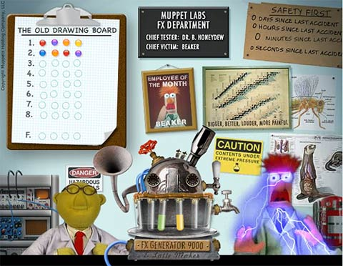
Objective #2
Safety Symbols, following directions, neatness, cleanup and safety equipment keep you safe because without them you could be in danger. Beaker sat in the chair that said CAUTION and was in for a shock! He can seriously injure himself for doing something stupid like not paying attention. Dr.Hunnydu drank the liquid in the test tubes and might get sick!

